Slide 1

Analyzing Amazon Sales Data: Uncovering Trends and Insights
data analytics intern
Presented by – Trijeta ghosh
Given By-Unified mENTOR

Slide 2
INTRODUCTION
The project revolves around conducting an in-depth analysis of sales data from Amazon, one of the world's largest e-commerce platforms. Through advanced analytics techniques, we aim to extract valuable insights from the dataset to better understand sales performance across different regions, product categories, and sales channels.
By descriptive, diagnostic, predictive, and prescriptive analytics, we will uncover patterns, trends, and relationships within the data. This analysis will enable us to address key business questions.
Through rigorous data analysis and visualization techniques, we will present our findings in a clear and concise manner, facilitating informed decision-making for stakeholders. Ultimately, this project aims to demonstrate the power of analytics in extracting actionable insights from complex datasets to drive business growth and success

Slide 3

Analysis Is Essential In This Project To Unlock Valuable Insights From The Sales Data, Drive Informed Decision-making, And Ultimately, Improve The Overall Performance And Profitability Of Amazon's Sales Operations
Need analysis
Understanding Performance
Identifying Opportunities
Optimizing Resources
Making Informed Decisions.
Improving Profitability
Unveiling Insights: Delving into Sales Data for Informed Decision-Making

Slide 4
key features and elements of the dashboard
Key Metrics:
Total Cost, Unit Cost, Total Profit, and Total Revenue are prominently displayed, providing an overview of financial performance.
Countries Wise Profit:
A world map visualization highlights profit levels across different countries, offering geographic insights into sales performance.
Total Profit by Region:
A pie chart illustrates the distribution of total profit among different regions, enabling users to understand regional contributions to overall profitability.
Profit Margin by Region:
A bar chart visualizes profit margins across regions, allowing users to compare profitability and identify areas for improvement.
Units Sold by Region:
A horizontal bar chart displays the number of units sold in each region, providing insights into sales volume distribution.
Total Profit by Region (Offline vs. Online):
Another bar chart compares the total profit generated from offline and online sales channels, helping users evaluate channel performance.
Cost and Revenue by Region:
A scatter plot with trend lines depicts the relationship between total cost and total revenue by region, offering insights into cost-effectiveness and revenue generation.
Total Profit by Region (Bar Chart):
A horizontal bar chart further visualizes total profit by region, facilitating easy comparison and analysis.
Ship Date Filter:
A list of ship dates enables users to filter data based on specific time periods, allowing for dynamic analysis and exploration.

Slide 5
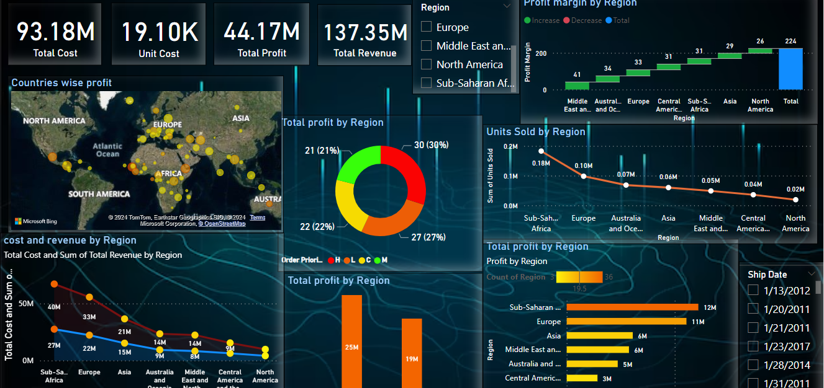
DASHBOARD
AMAZON SALE DATA

Slide 6
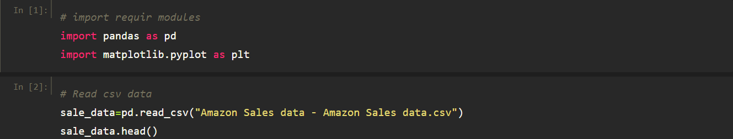
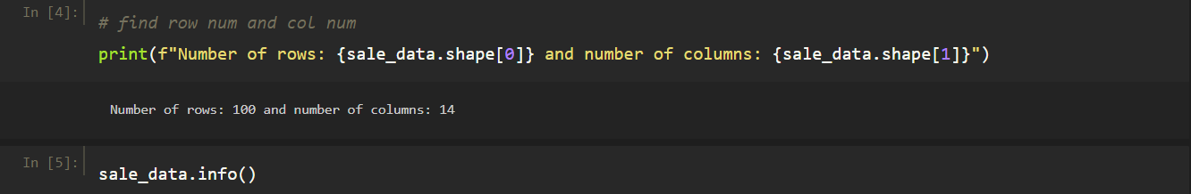

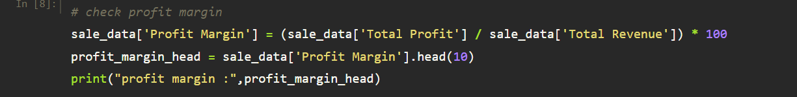
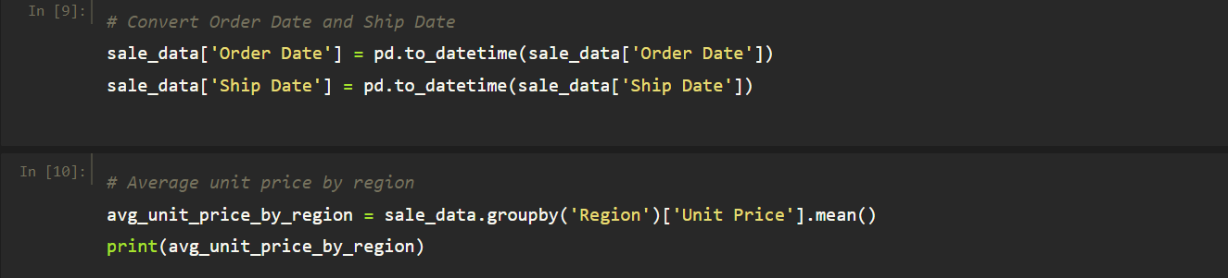
Reading CSV Data: Data is imported from a CSV file and stored in a DataFrame. Accessing Column Names: An attempt to access column names is made, with a minor typo observed. Finding Row and Column Numbers: Number of rows and columns in the DataFrame are printed. Checking for Missing Values: Presence of missing values in each column is assessed. Summary Statistics: Descriptive statistics for numerical columns are generated. Calculating Profit Margin: Profit margin is computed for each entry in the dataset and displayed. Converting Date Columns: 'Order Date' and 'Ship Date' columns are converted to datetime format. Average Unit Price by Region: The average unit price is calculated for each region. Descriptive Points: Request for a description of the project.
BY PYTHON

Slide 7
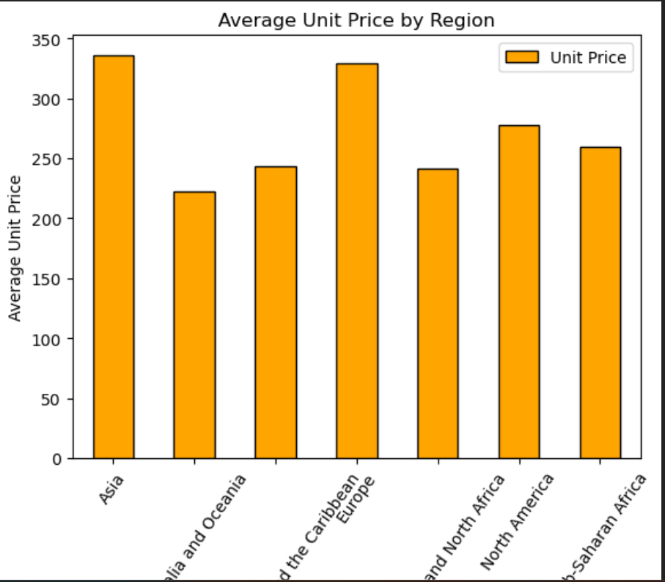
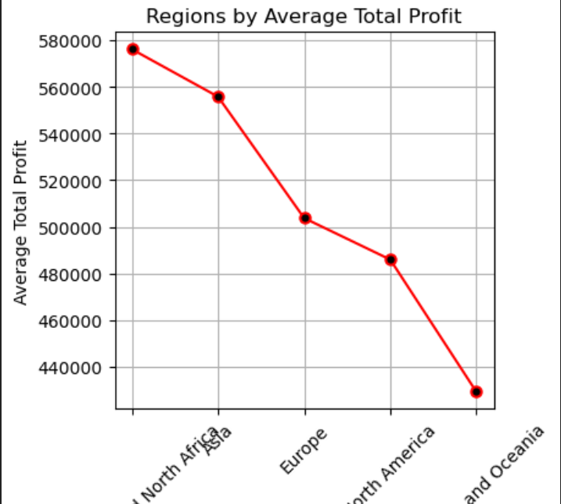
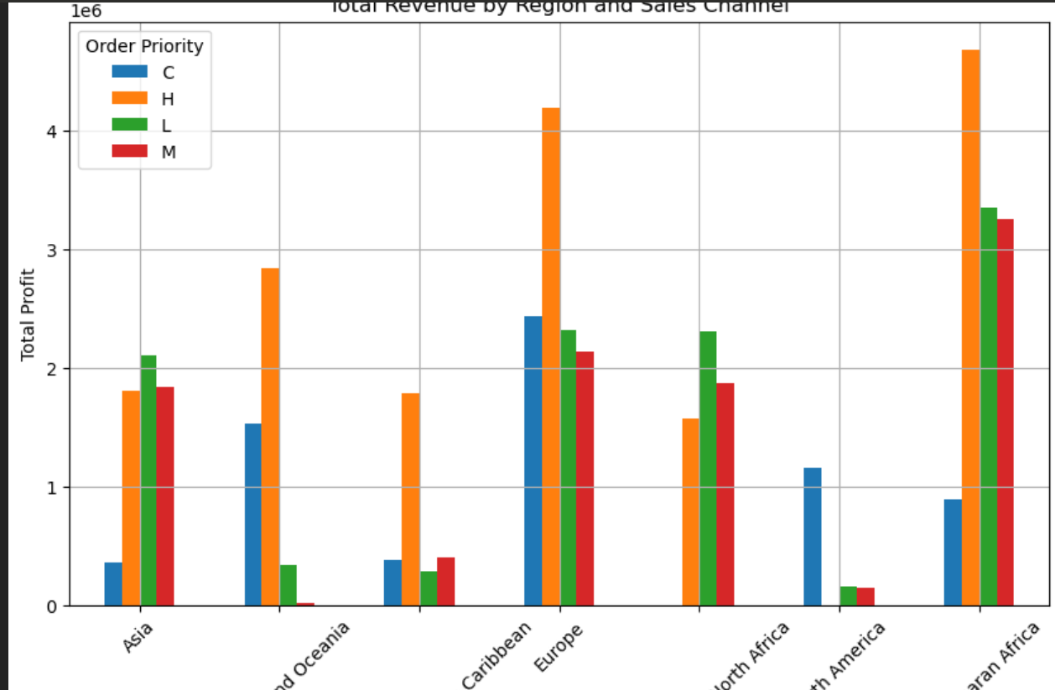
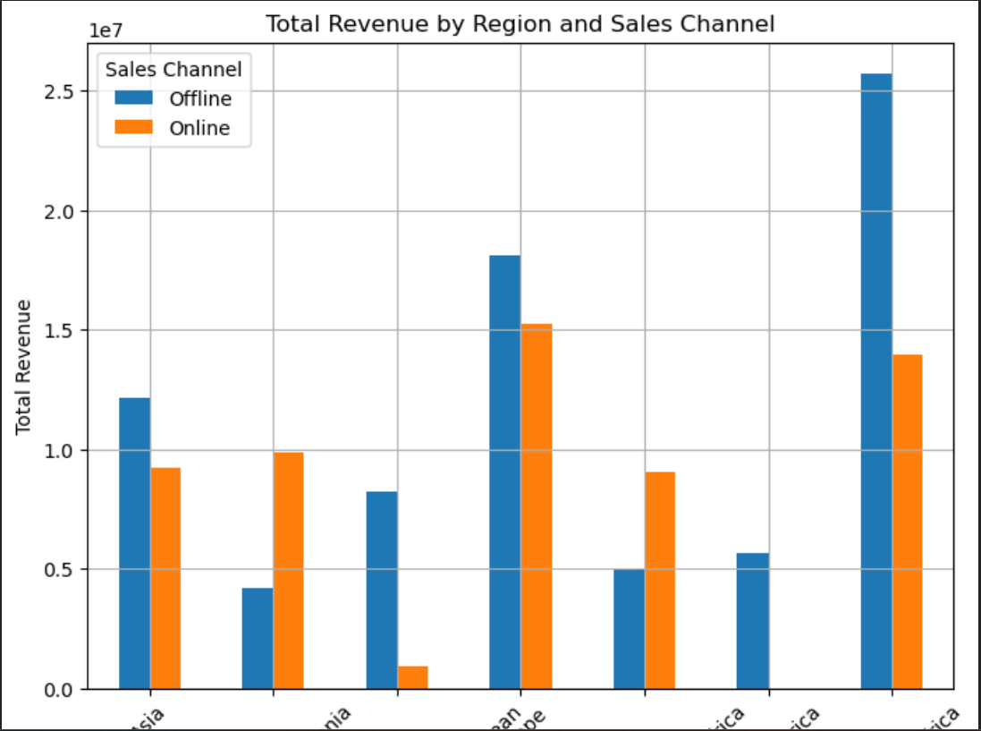
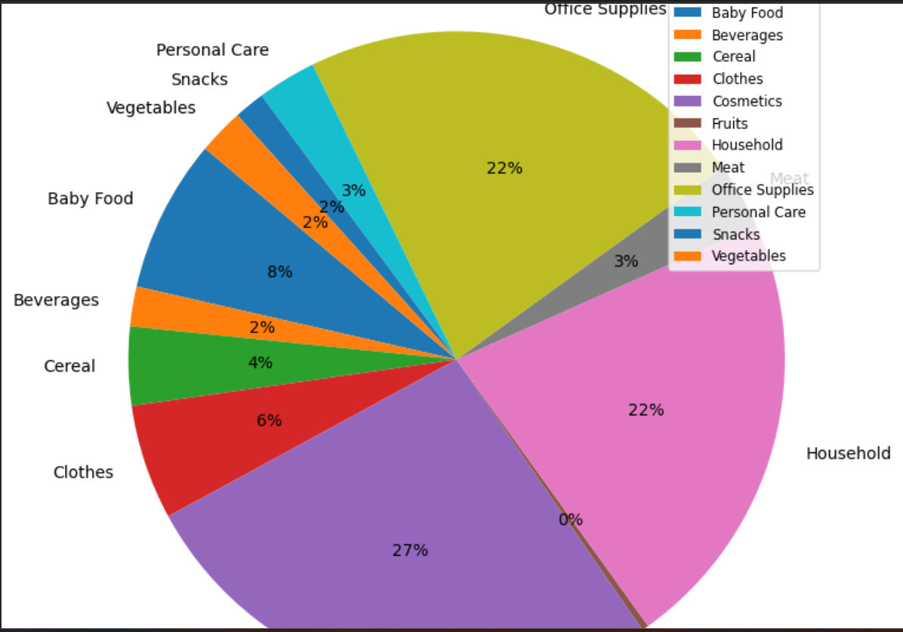
Observations
.
Average unit price by region
Region by Average Total Profit
Total Revenue by Region and Sales Channel
Total Revenue by Region and Sales Channel
Total Sales by Item

